Slide 1
CEN-300
Vehicle Trajectory Prediction using Aerial Images and Object Detection
Agam Pandey (22113009) | Hardik Chawla (22113056) |
Krish Sharma (22124021) | Samarth ()

Slide 2
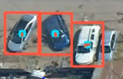
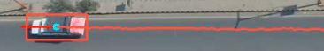
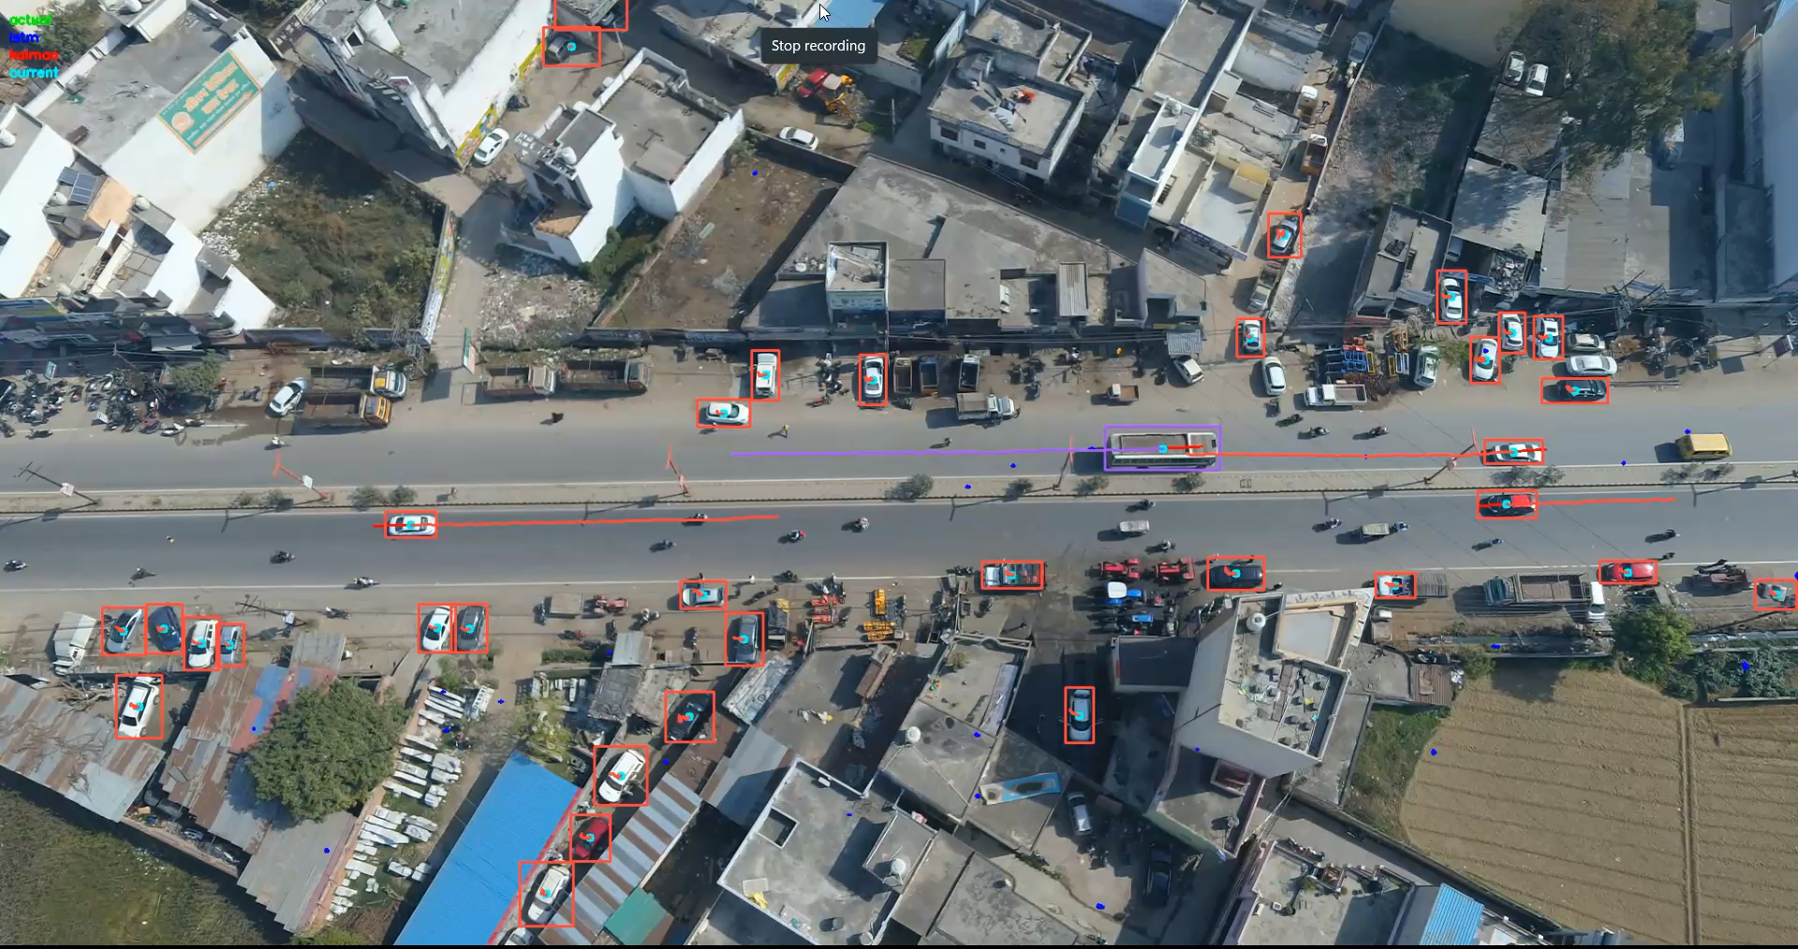
Tracking vehicle movements in real-time, mapping trajectories, predicting future trajectories, aiding in collision detection and prevention.
Object Detection
Predicted Trajectory Path
Past Trajectory
YOLOv8 for Object Detection : Frame wise vehicles are identified.
ByteTrack for Object Tracking : Unique-ID assigned to each detected vehicles and tracks their movement over time.
LSTM for Trajectory Prediction
Kalman Filter for Smoother Predictions : Noise reduction and path refinement.

Slide 3
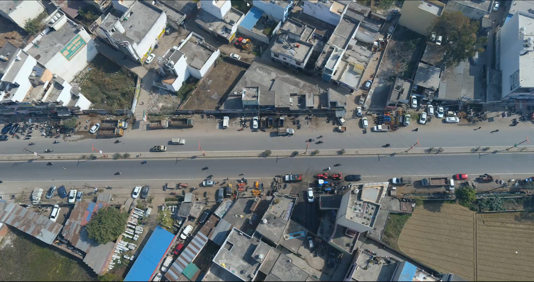
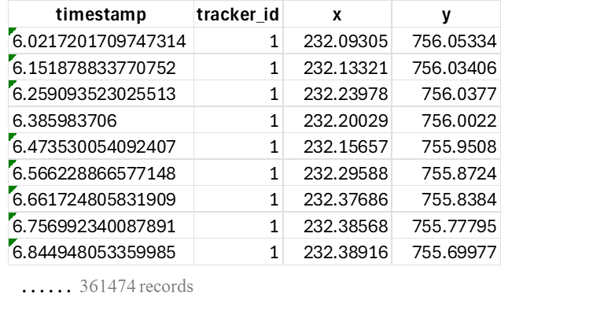
Technical Implementation
1. DATA COLLECTION
DATA STORAGE
frame, timestamp, vehicle_id, x, y
2. OBJECT DETECTION : YOLOv8
Model used : Pre-trained YOLOv8 (Ultralytics)
Library : supervision (Roboflow) for processing detections
Thresholds : Confidence = 0.3 ; IoU = 0.7
Output : Bounding boxes for each vehicle
5. TRAJECTORY PREDICTIONS
Kalman Filter (Physics-based)
Handles noisy detections & smooths trajectory
LSTM (DL-based)
Predicts next 10 frames for each vehicle
3. OBJECT TRACKING : ByteTrack
Ensures consistent vehicle IDs across frames
Storing vehicle movement data

Slide 4
Scope for Improvement
Fine-tuned YOLO Model for Detection & Tracking : Improving accuracy in challenging conditions (night, foggy, etc.)
More data for LSTM training
Exploring SOTA models for trajectory prediction
Integrate Predicted Trajectories with Driver Data

Slide 5
THANKS

